Slide 1
Route 53 - Global DNS
Here we’ll do all about Route 53 for Associate Exam

Slide 2
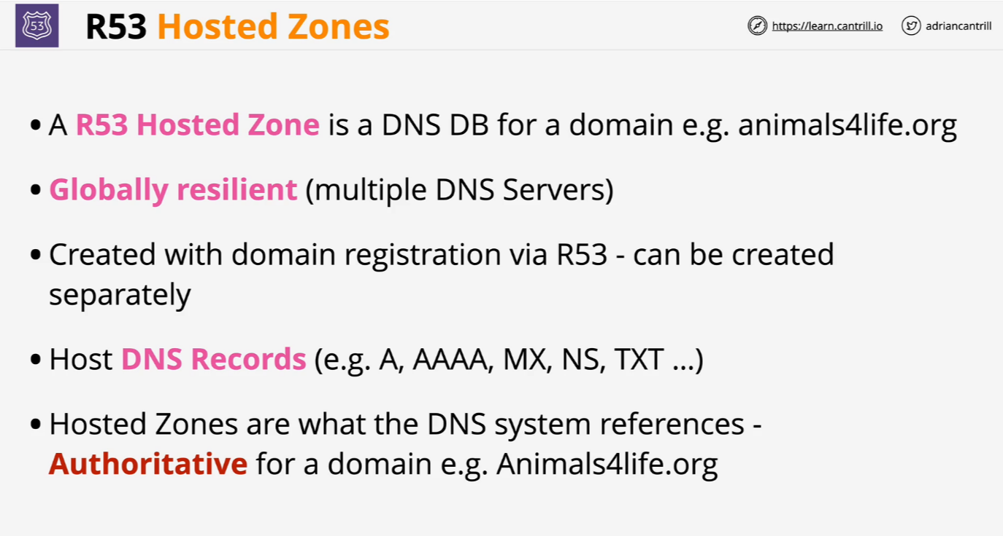
R53 Public Hosted Zones

Slide 3
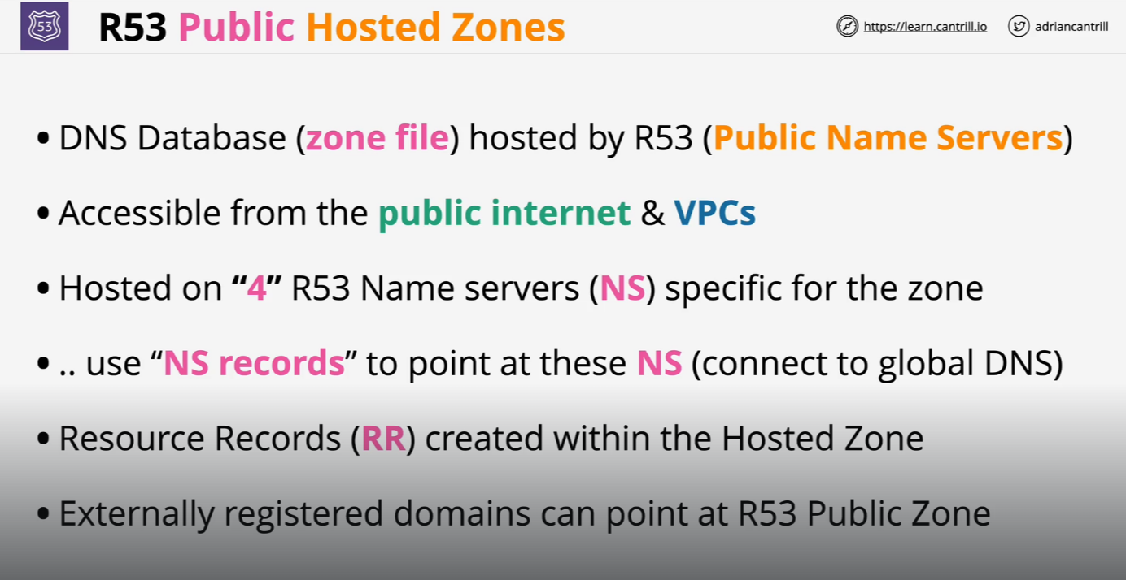
R53 Public Hosted Zones

Slide 4
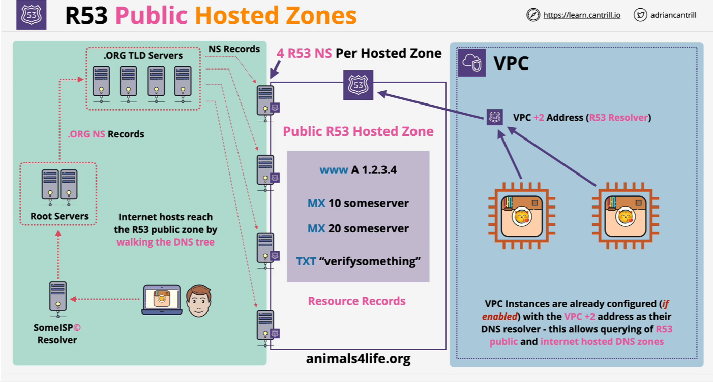
R53 Public Hosted Zones

Slide 5
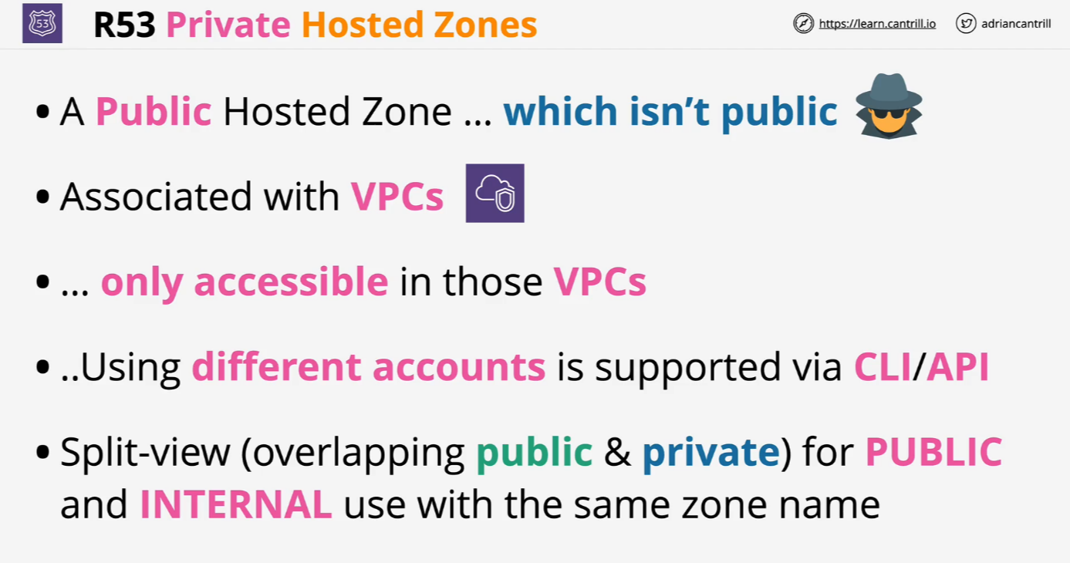
R53 Private Hosted Zones

Slide 6
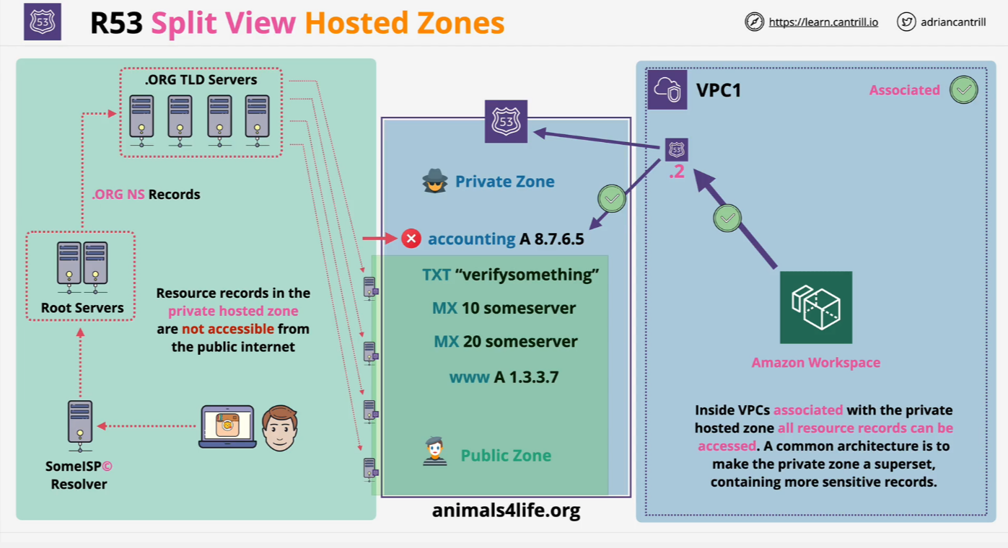
R53 Private Hosted Zones

Slide 7
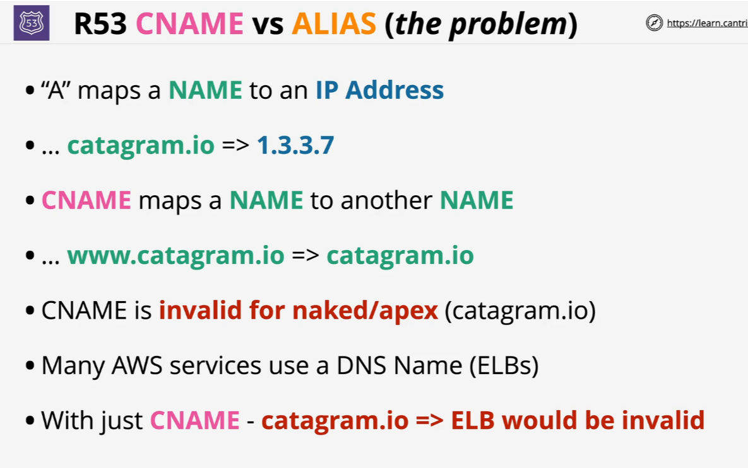
CNAME vs R53 Alias

Slide 8
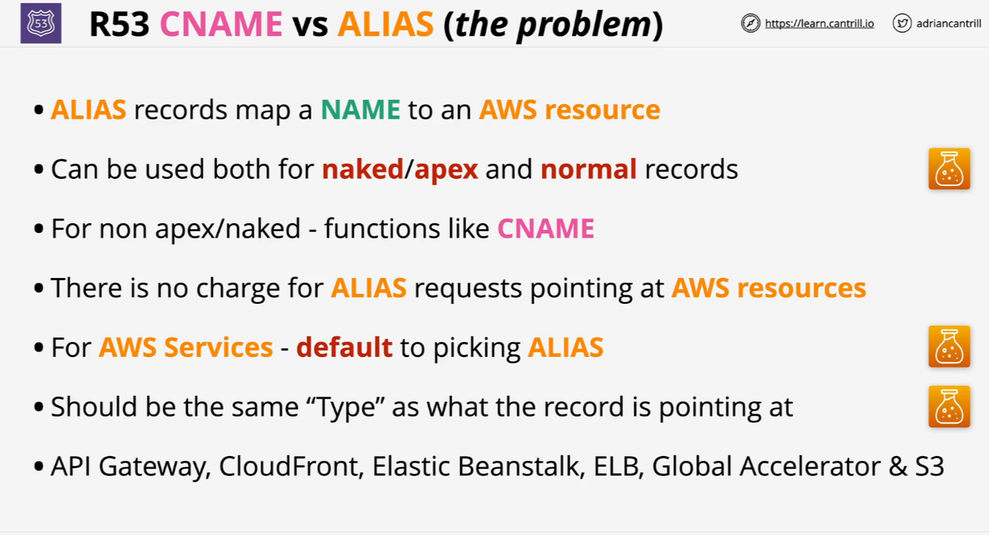
CNAME vs R53 Alias

Slide 9
CNAME vs R53 Alias
When managing DNS records, it's important to understand the differences between CNAME and ALIAS records:
CNAME (Canonical Name) Records:
Function: Redirect one domain name to another. For example, pointing www.example.com to example.com.
Limitations:
Cannot be used at the root level of a domain (also known as the zone apex).
Cannot coexist with other records of the same name.
ALIAS Records:
Function: Provide CNAME-like functionality at the zone apex, allowing a domain to point to another domain or service.
Advantages:
Can be used at the root level of a domain.
Can coexist with other records of the same name.

Slide 10
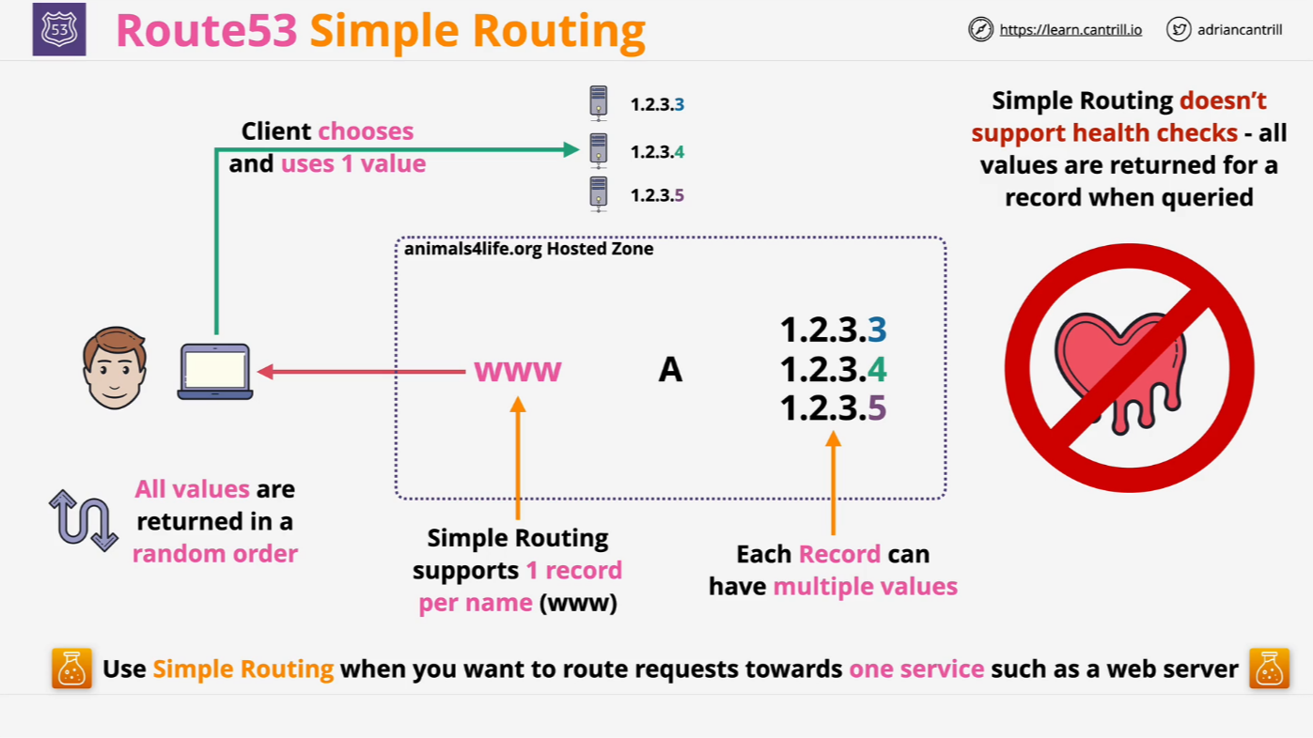
Simple Routing

Slide 11
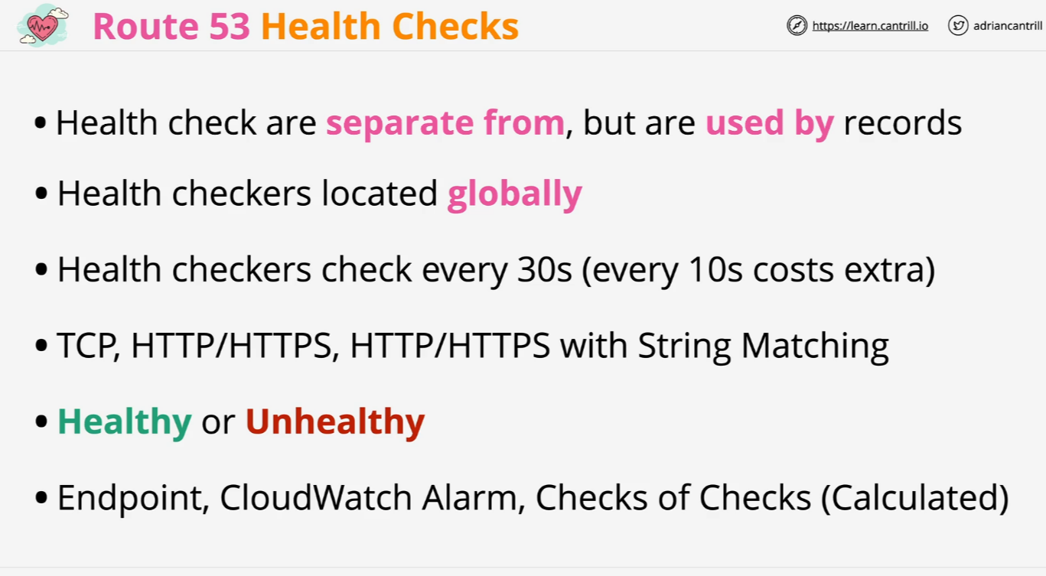
R53 Health Checks

Slide 12
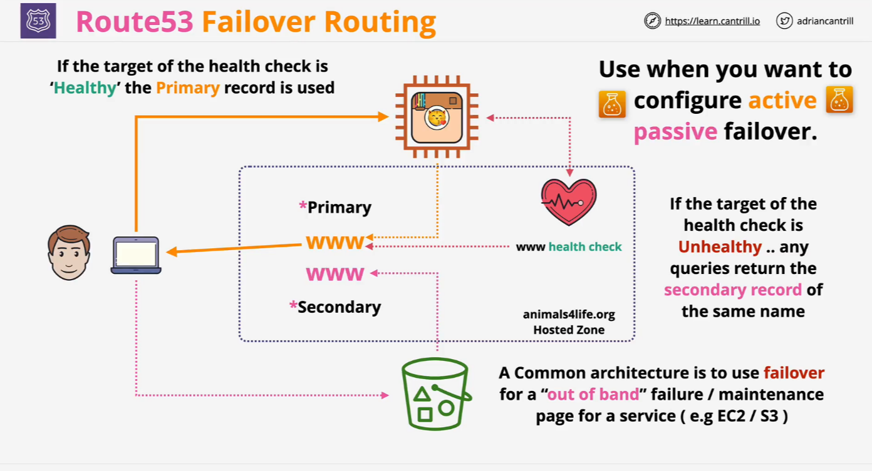
Failover Routing

Slide 13
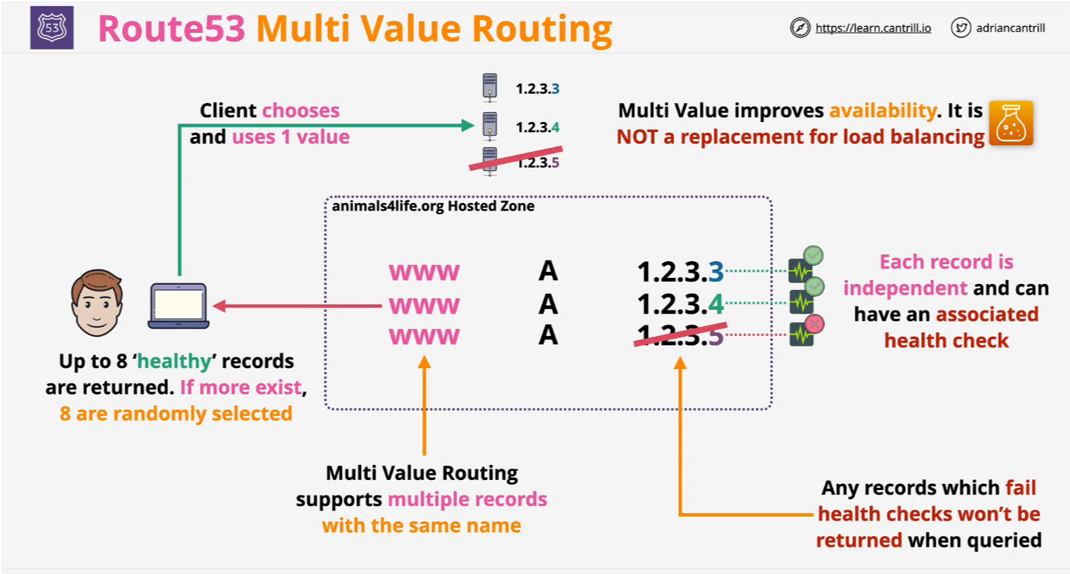
Multi Value Routing

Slide 14
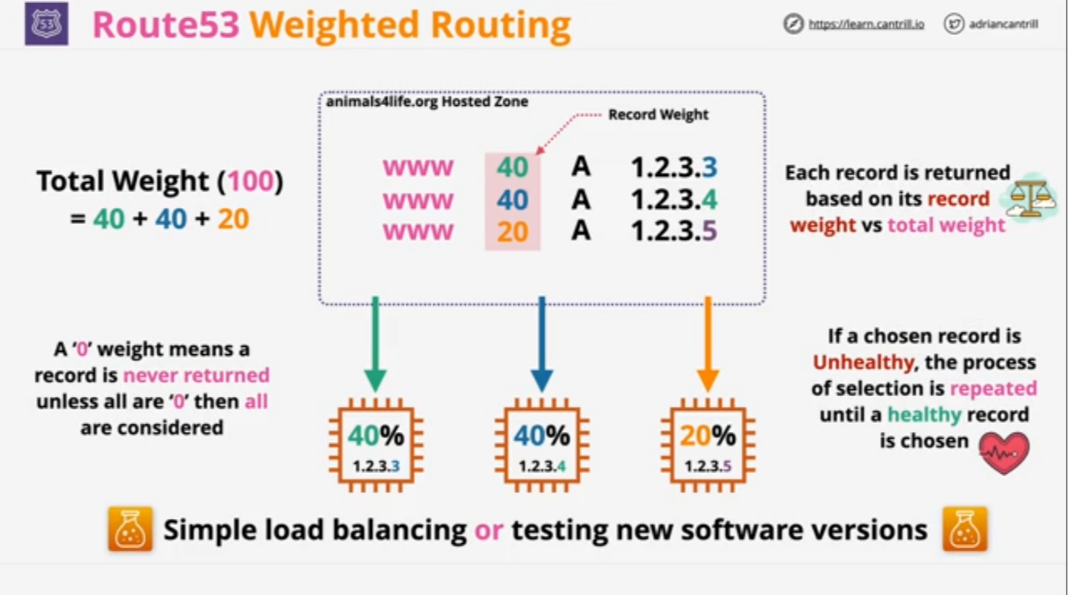
Weighted Routing

Slide 15
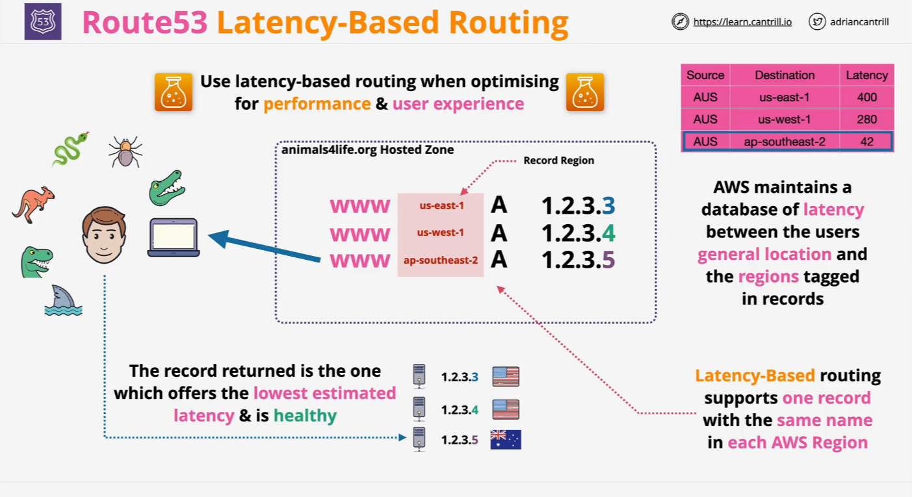
Latency Routing

Slide 16
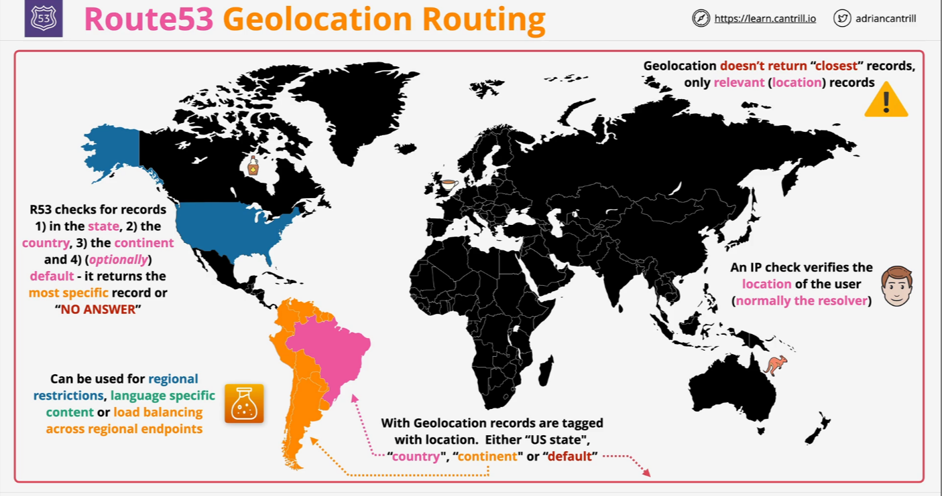
Geolocation Routing

Slide 17
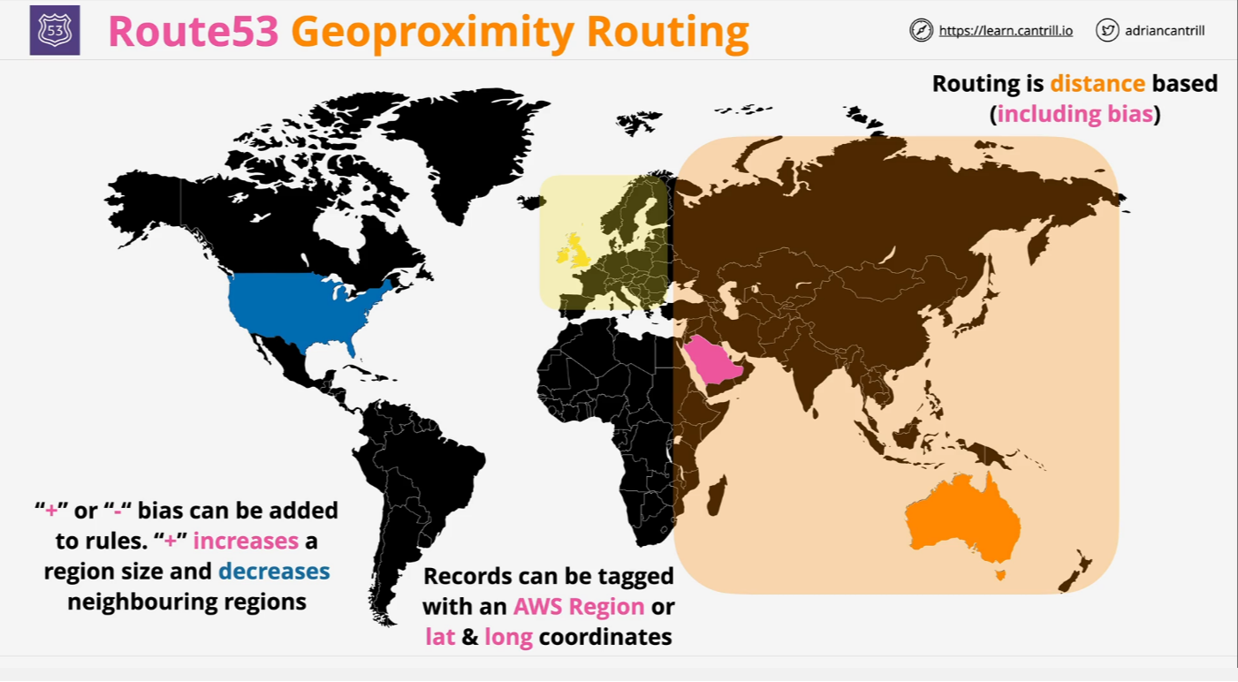
Geoproximity

Slide 18
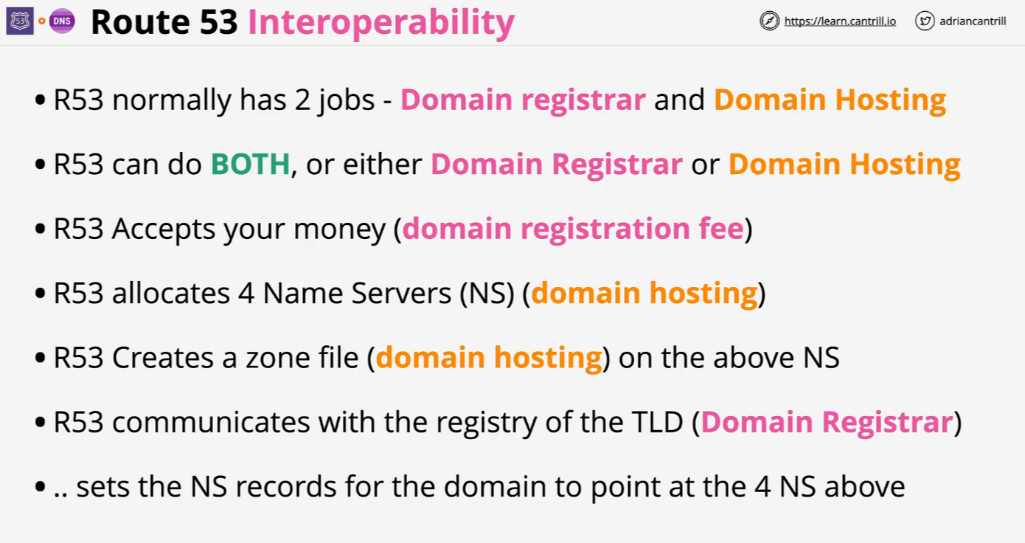
R53 Interoperability

Slide 19
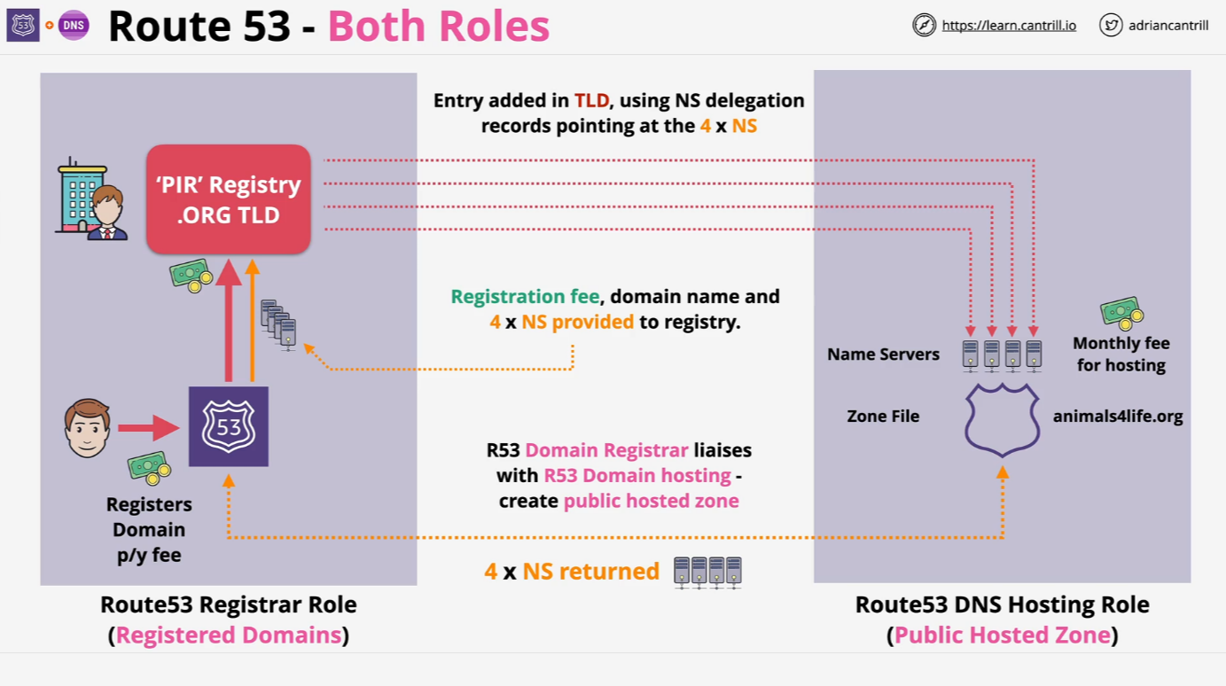
R53 Interoperability – Both Roles

Slide 20
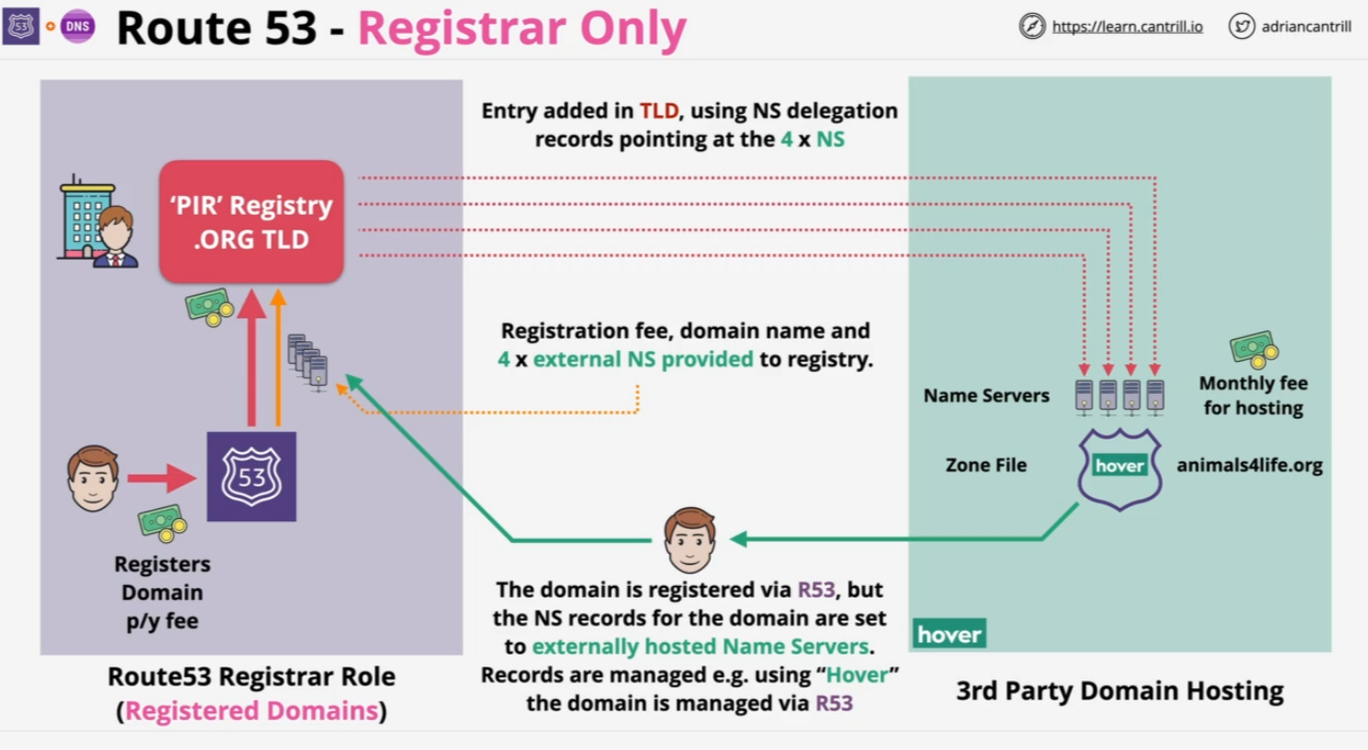
R53 Interoperability – Registrar Only

Slide 21
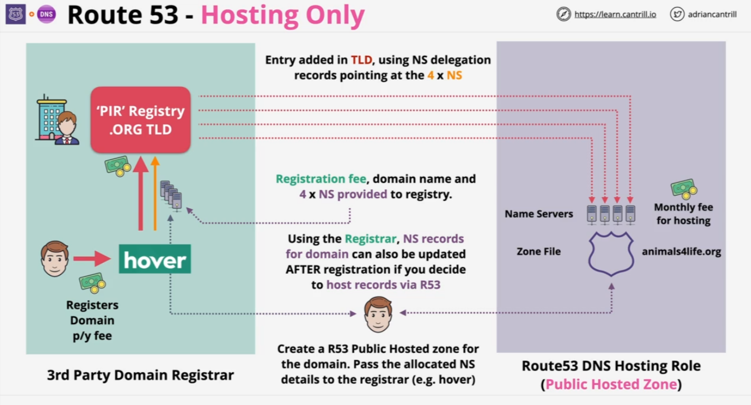
R53 Interoperability – Hosting Only

Slide 22
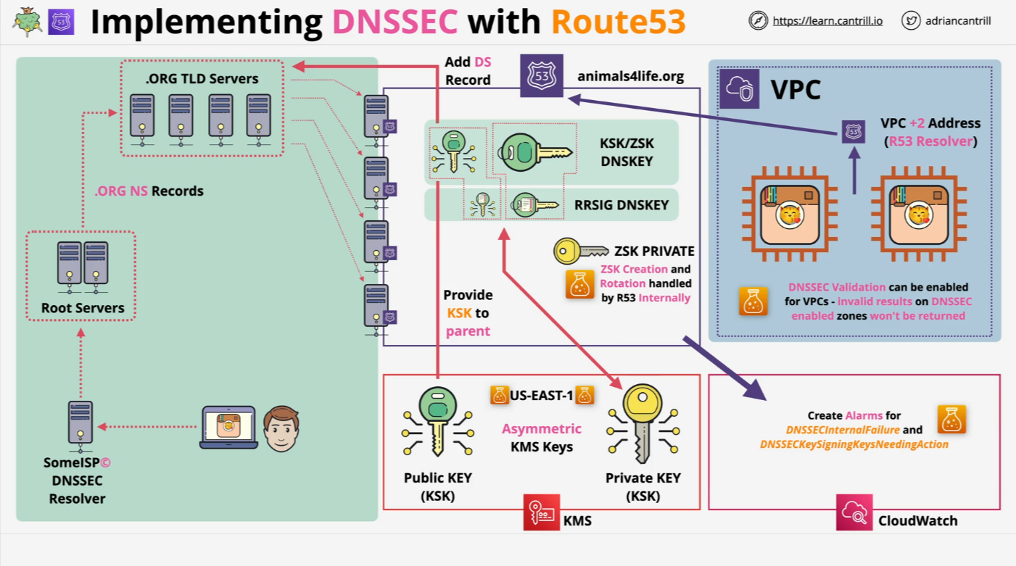
Implementing DNSSEC using Route53

Slide 23
Implementing DNSSEC using Route53
Implementing DNSSEC (Domain Name System Security Extensions) in Amazon Route 53 enhances the security of your domain by ensuring that DNS responses are authentic and have not been tampered with. DNSSEC achieves this by digitally signing DNS records using public-key cryptography, allowing DNS resolvers to verify the integrity and origin of the data.
By enabling DNSSEC in Route 53, you protect your domain from various attacks, such as cache poisoning and spoofing, thereby maintaining the trustworthiness of your domain's DNS information

